Slide 1
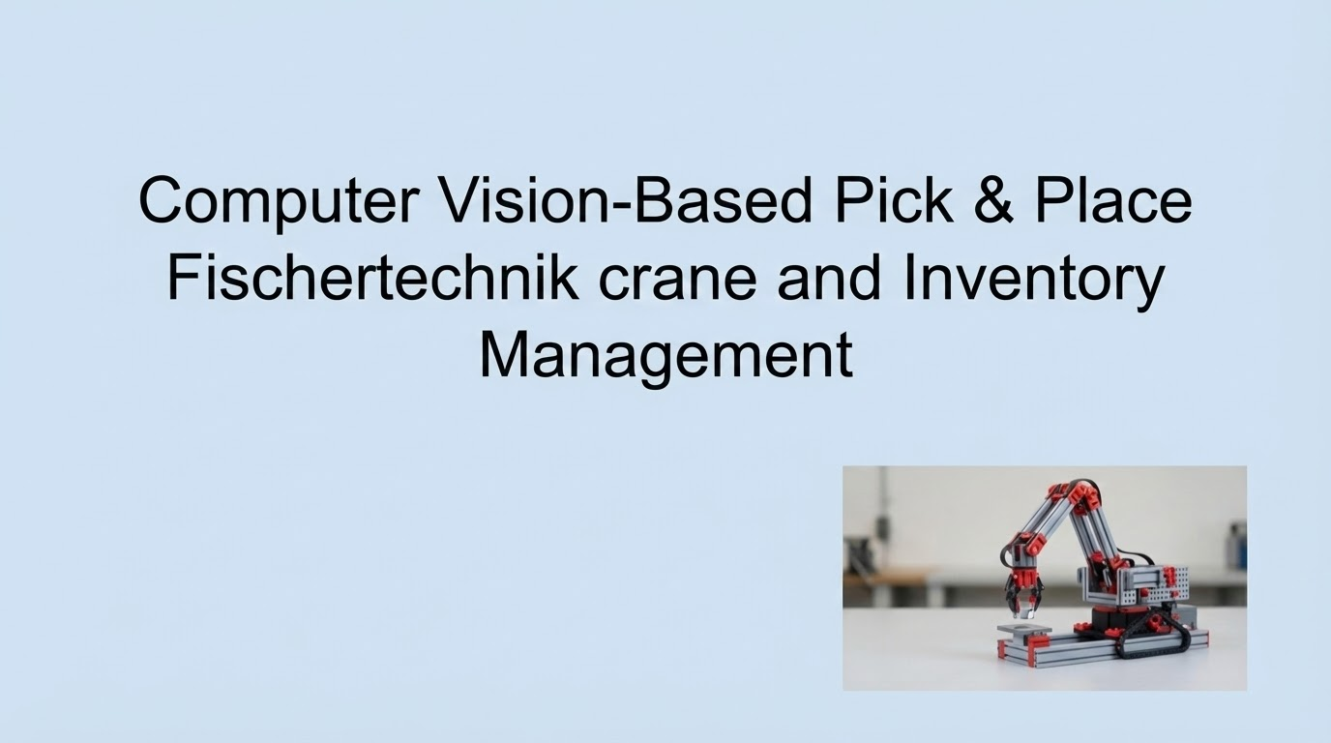
Interim Presentation

Slide 2
Problem Statement
Automate the process of picking, storing, and dispatching orders using microcontrollers and computer vision.
Improve accuracy and efficiency in warehouse logistics.
Integrate object detection with inventory control.

Slide 3
Hardware Used
Raspberry Pi 5 + 4-channel Relay
Electromagnet
DC Motors for movement of crane
Camera Module (for Computer vision)

Slide 4
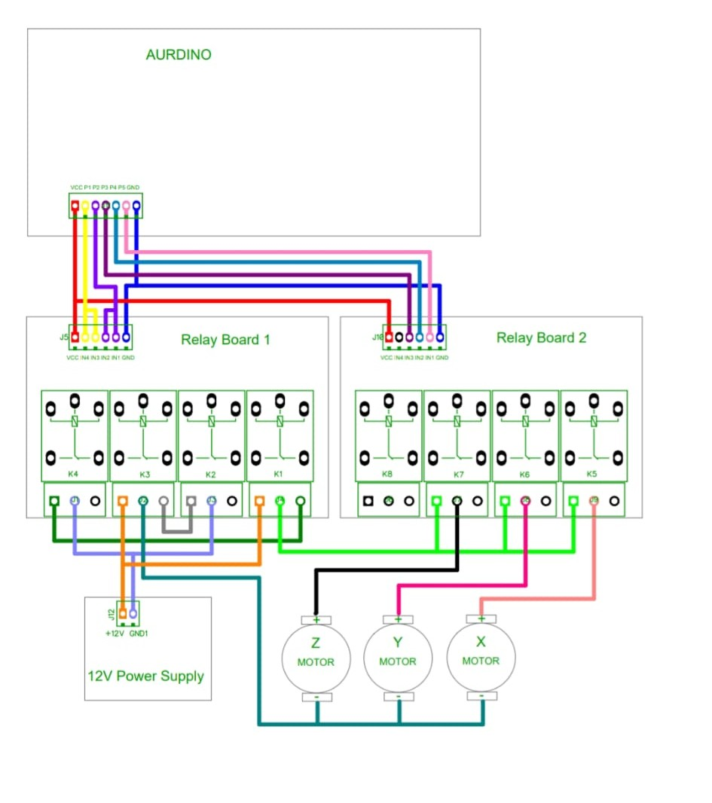
Hardware Setup
Raspberry Pi controls two 4-channel relay boards using digital output pins.
Relays switch a 12 V supply to drive three DC motors (X, Y, Z).
Each motor uses two relays for forward and reverse motion.
Relay isolation protects the Arduino from high motor currents.

Slide 5
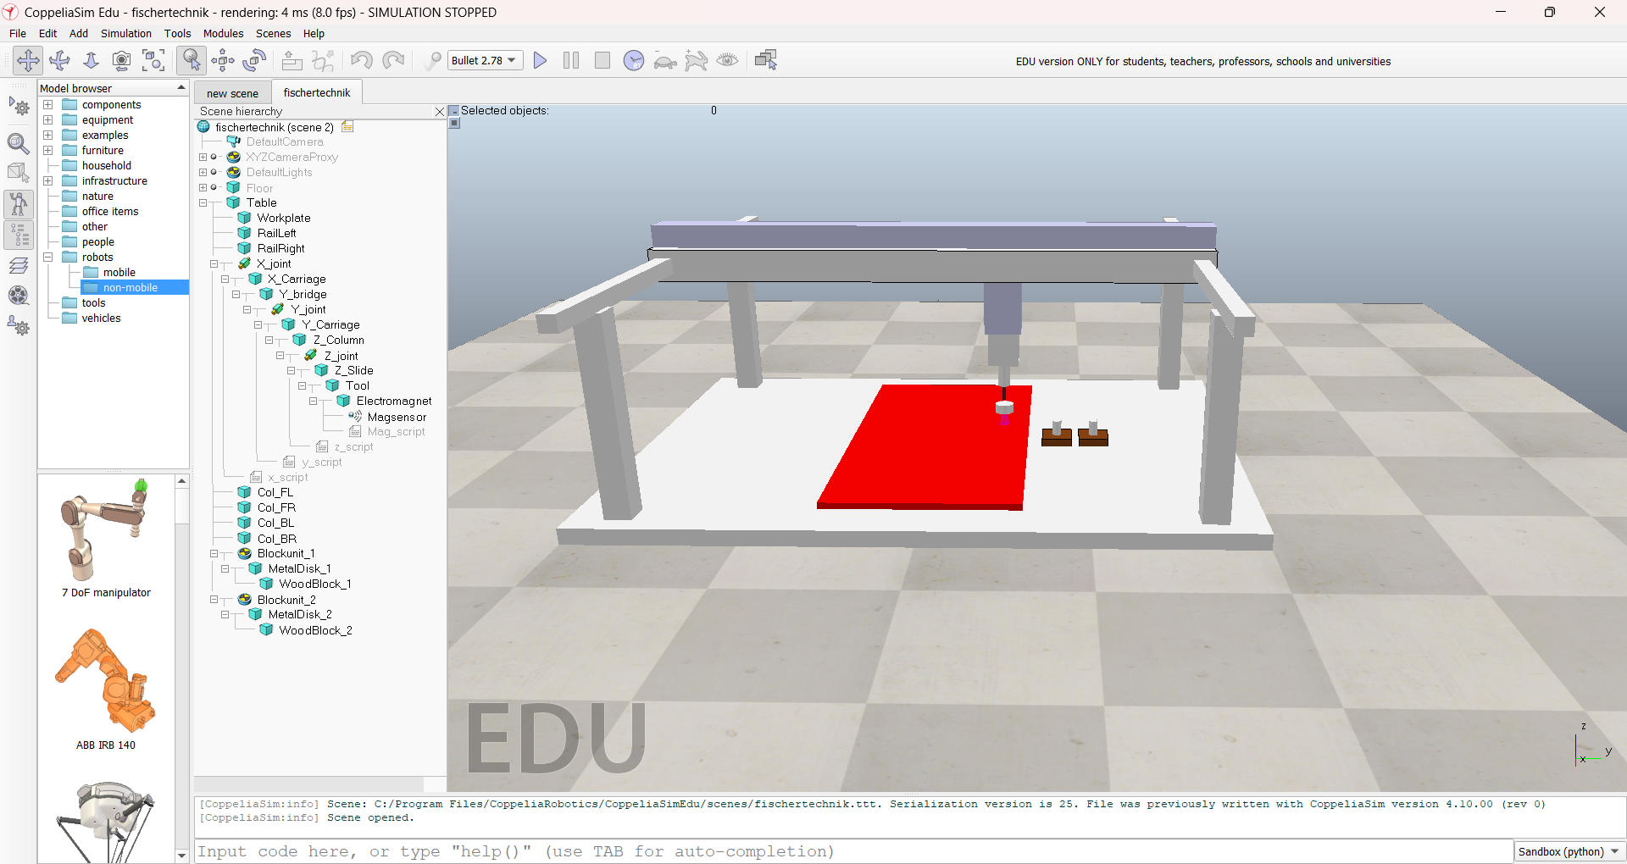
Digital Twin Setup (CoppeliaSim)
A 3-axis gantry system (X, Y, Z) is modeled in CoppeliaSim to replicate the physical setup.
Each axis is implemented using prismatic joints with realistic motion limits.
An electromagnet end-effector is used for pick-and-place operations.
The simulation mirrors the real hardware behavior, enabling testing and validation before deployment.

Slide 6
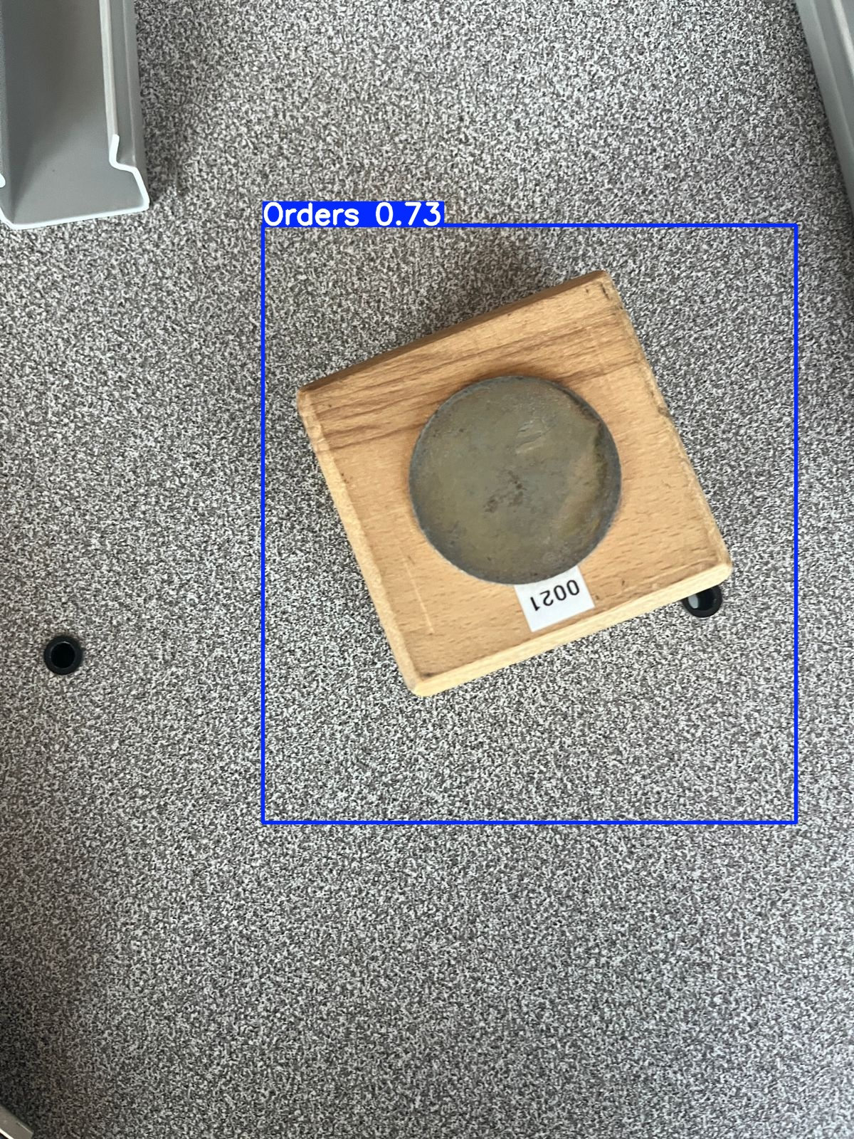
Object Detection and Integration
Labelling the objects and model training for object detection using Ultralytics yolo11s.pt ✅
Developing algorithm to load the model, run inference on image and draw bounding boxes around the objects with confidence scores ✅
Integration of object detection model with motor movements to implement fully autonomous system✅

Slide 7
Model Evaluation And Further Improvement
Model evaluation performed on validation datasets and the results are shown in Table 1
As we took very less pictures while model training, the performance of the model is moderate though the inference is quite hgh (5.0 s per object) which looks good
Converted pytorch model to onnx format which resulted significant improvement in FPS and inference on image
We will train the model again with more pictures and validate again for more accurate results .
MAP@50 | 50%
MAP@50-90 | 51%
Precision | 53%
Recall | 55%
Inference | 5.0 s
Table 1

Slide 8
User interface
Created UI for real time tracking of dispatched orders with FastAPI for backend and Streamlit for frontend ✅
Integrated with the whole system to make it user friendly ✅

Slide 9
Next steps
Converting the object detection model to more robust for integrating with the whole system and implementing FIFO storage policy
Implementing OCR for extracting serial template numbers and integrating with the user interface to show the dispatched order numbers in real time
Integrating Digital twin with the system

Slide 10
THANK YOU.. Any questions?

